Slide 1


Slide 3


Financial Statement Analysis of Apple Inc.

Slide 4

Description of the Business
Apple Inc. is a multinational technology company that designs, manufactures, and sells consumer electronics, software, and online services. The company is best known for its innovative products, including the iPhone, iPad, Mac, Apple Watch, and Apple TV.In addition to its hardware, Apple offers a range of services such as the App Store, Apple Music, iCloud, and Apple Pay. These services provide users with access to a wide variety of apps, music, storage, and payment solutions.Apple's target market primarily consists of individuals and businesses who value high-quality, user-friendly technology products. The company has a strong brand presence and a loyal customer base that spans across the globe.

Slide 5

Current Business
Product Release
iPad Pro 12.9-inch : A new 12.9-inch iPad Pro is expected to be released in March 2024. It is rumored to have a mini-LED display, an M3 chip, and a new design.

Slide 6











Future Plans
Brand new Colours
Apple Podcasts
Heartbeat Sensor
Tracks
Workout
Flat Sided
Design
4K
Apple Maps
4k60 fps
Camera
Apple Music
Fast
Charging
Powerful
Chip
All day Battery
Wi-Fi 6
Improved Siri
Apple Maps

Slide 7



Apple is focused on expanding its product offerings and growing its services business. The company is also investing in new technologies, such as artificial intelligence and augmented reality. Apple is also committed to environmental sustainability and is working to reduce its carbon footprint.

Slide 8

Strategy For The Future
Growth :Apple plans to continue its growth by expanding into new markets and diversifying its product offerings.
Innovation: Innovation is at the core of Apple's strategy, and the company plans to continue developing groundbreaking products and technologies.
Market Expansion: Apple aims to expand its presence in existing markets and enter new markets to reach a wider customer base.

Slide 9
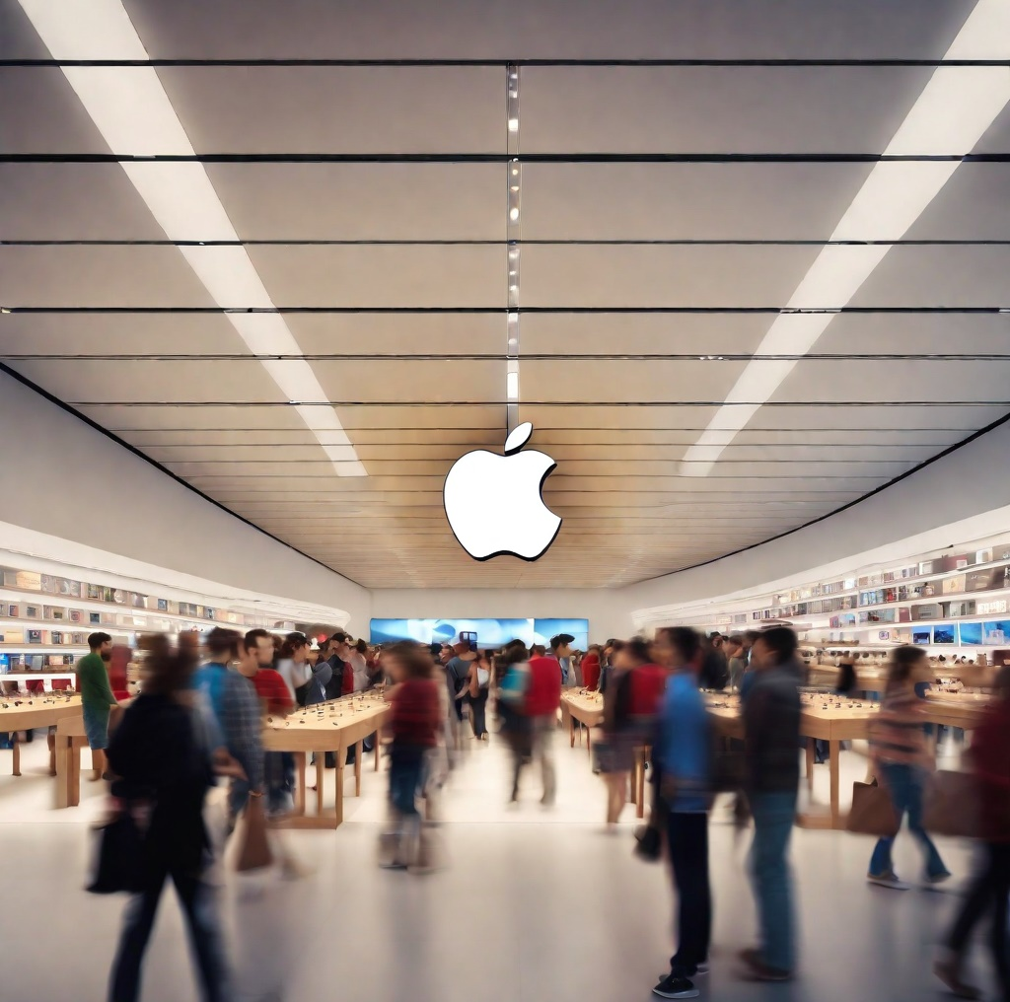
Risks
Competition: Apple faces intense competition from other technology companies, such as Samsung, Google, and Microsoft. These companies constantly innovate and release new products, which could impact Apple's market share and profitability.
Regulatory Changes: Changes in regulations and laws, both domestically and internationally, can impact Apple's business operations. For example, changes in tax laws or import/export regulations could affect Apple's profitability and supply chain.
Technological Advancements: The rapid pace of technological advancements poses a risk to Apple's business. New technologies and innovations could render Apple's products obsolete or less desirable, leading to a decline in sales and market share.

Slide 10
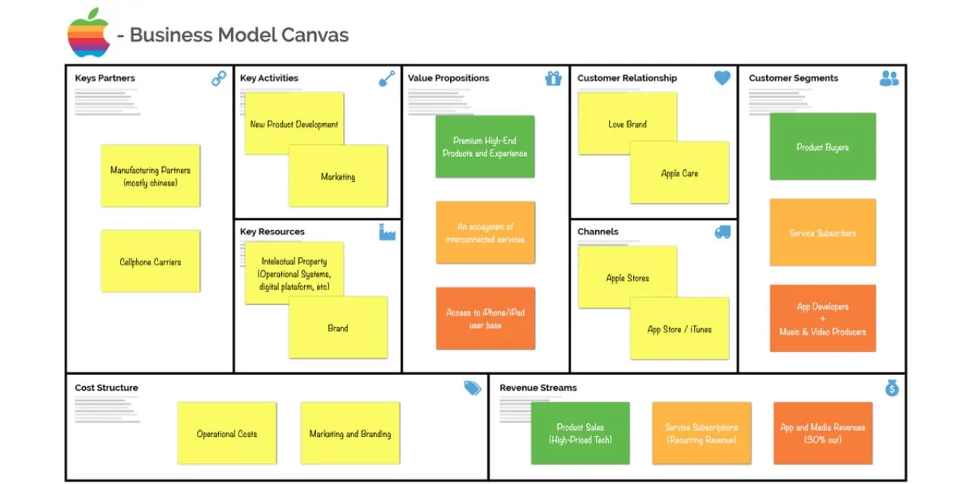

Slide 11
Financial Statement and Insights
Consolidated: Common-size Income Sheet
 | Sep-23 | % to net sales | Sep-22 | % to net sales | Sep-21 | % to net sales
Net sales:
Products | $ 298,085.00 | 77.77% | $ 316,199.00 | 80.19% | $ 297,392.00 | 81.30%
Services | $ 85,200.00 | 22.23% | $ 78,129.00 | 19.81% | $ 68,425.00 | 18.70%
Total net sales | $ 383,285.00 | 100.00% | $ 394,328.00 | 100.00% | $ 365,817.00 | 100.00%
Cost of sales:
Products | $ 189,282.00 | 49.38% | $ 201,471.00 | 51.09% | $ 192,266.00 | 52.56%
Services | $ 24,855.00 | 6.48% | $ 22,075.00 | 5.60% | $ 20,715.00 | 5.66%
Total cost of sales | $ 214,137.00 | 55.87% | $ 223,546.00 | 56.69% | $ 212,981.00 | 58.22%
Gross margin | $ 169,148.00 | 44.13% | $ 170,782.00 | 43.31% | $ 152,836.00 | 41.78%
Operating expenses:
Research and development | $ 29,915.00 | 7.80% | $ 26,251.00 | 6.66% | $ 21,914.00 | 5.99%
Selling, general and administrative | $ 24,932.00 | 6.50% | $ 25,094.00 | 6.36% | $ 21,973.00 | 6.01%
Total operating expenses | $ 54,847.00 | 14.31% | $ 51,345.00 | 13.02% | $ 43,887.00 | 12.00%
Operating income | $ 114,301.00 | 29.82% | $ 119,437.00 | 30.29% | $ 108,949.00 | 29.78%
Other income/(expense), net | $ -565.00 | -0.15% | $ -334.00 | -0.08% | $ 258.00 | 0.07%
Income before provision for income taxes | $ 113,736.00 | 29.67% | $ 119,103.00 | 30.20% | $ 109,207.00 | 29.85%
Provision for income taxes | $ 16,741.00 | 4.37% | $ 19,300.00 | 4.89% | $ 14,527.00 | 3.97%
Net income | $ 96,995.00 | 25.31% | $ 99,803.00 | 25.31% | $ 94,680.00 | 25.88%

Slide 12

Financial Statement and Insights
Consolidated: Common-size Balance Sheet
 |  |  | Sept, 2023 | % to Total Assets | Sept, 2022 | % to Total Assets | Sept, 2021 | % to Total Assets
ASSETS:
Current assets:
Cash and cash equivalents |  |  | $ 29,965.00 | 8.50% | $ 23,646.00 | 6.70% | $ 34,940.00 | 9.95%
Marketable securities |  |  | $ 31,590.00 | 8.96% | $ 24,658.00 | 6.99% | $ 27,699.00 | 7.89%
Accounts receivable, net |  |  | $ 29,508.00 | 8.37% | $ 28,184.00 | 7.99% | $ 26,278.00 | 7.49%
Vendor non-trade receivables |  |  | $ 31,477.00 | 8.93% | $ 32,748.00 | 9.28% | $ 25,228.00 | 7.19%
Inventories |  |  | $ 6,331.00 | 1.80% | $ 4,946.00 | 1.40% | $ 6,580.00 | 1.87%
Other current assets |  |  | $ 14,695.00 | 4.17% | $ 21,223.00 | 6.02% | $ 14,111.00 | 4.02%
Total current assets |  |  | $143,566.00 | 40.72% | $ 135,405.00 | 38.38% | $ 134,836.00 | 38.41%
Non-current assets:
Marketable securities |  |  | $100,544.00 | 28.52% | $ 120,805.00 | 34.25% | $ 127,877.00 | 36.43%
Property, plant and equipment, net |  |  | $ 43,715.00 | 12.40% | $ 42,117.00 | 11.94% | $ 39,440.00 | 11.24%
Other non-current assets |  |  | $ 64,758.00 | 18.37% | $ 54,428.00 | 15.43% | $ 48,849.00 | 13.92%
Total non-current assets |  |  | $209,017.00 | 59.28% | $ 217,350.00 | 61.62% | $ 216,166.00 | 61.59%
Total assets |  |  | $352,583.00 | 100.00% | $ 352,755.00 | 100.00% | $ 351,002.00 | 100.00%
 |  |  | Sept, 2023 | % to Total Assets | Sept, 2022 | % to Total Assets | Sept, 2021 | % to Total Assets
LIABILITIES AND SHAREHOLDERS’ EQUITY:
Current liabilities:
Accounts payable |  |  | $ 62,611.00 | 17.76% | $ 64,115.00 | 18.18% | $ 54,763.00 | 15.60%
Other current liabilities |  |  | $ 58,829.00 | 16.69% | $ 60,845.00 | 17.25% | $ 47,493.00 | 13.53%
Deferred revenue |  |  | $ 8,061.00 | 2.29% | $ 7,912.00 | 2.24% | $ 7,612.00 | 2.17%
Commercial paper |  |  | $ 5,985.00 | 1.70% | $ 9,982.00 | 2.83% | $ 6,000.00 | 1.71%
Term debt |  |  | $ 9,822.00 | 2.79% | $ 11,128.00 | 3.15% | $ 9,613.00 | 2.74%
Total current liabilities |  |  | $145,308.00 | 41.21% | $ 153,982.00 | 43.65% | $ 125,481.00 | 35.75%
Non-current liabilities:
Term debt |  |  | $ 95,281.00 | 27.02% | $ 98,959.00 | 28.05% | $ 109,106.00 | 31.08%
Other non-current liabilities |  |  | $ 49,848.00 | 14.14% | $ 49,142.00 | 13.93% | $ 53,325.00 | 15.19%
Total non-current liabilities |  |  | $145,129.00 | 41.16% | $ 148,101.00 | 41.98% | $ 162,431.00 | 46.28%
Total liabilities |  |  | $290,437.00 | 82.37% | $ 302,083.00 | 85.64% | $ 287,912.00 | 82.03%
Shareholders’ equity:
Common stock |  |  | $ 73,812.00 | 20.93% | $ 64,849.00 | 18.38% | $ 57,365.00 | 16.34%
Accumulated deficit |  |  | $ -214.00 | -0.06% | $ -3,068.00 | -0.87% | $ 5,562.00 | 1.58%
Accumulated other comprehensive loss |  |  | $ -11,452.00 | -3.25% | $ -11,109.00 | -3.15% | $ 163.00 | 0.05%
Total shareholders’ equity |  |  | $ 62,146.00 | 17.63% | $ 50,672.00 | 14.36% | $ 63,090.00 | 17.97%
Total liabilities and shareholders’ equity |  |  | $352,583.00 | 100.00% | $ 352,755.00 | 100.00% | $ 351,002.00 | 100.00%

Slide 13
Ratio Analysis
Liquidity Ratios
 | Sep 30, 2023 | Sep 24, 2022 | Sep 25, 2021 | Sep 26, 2020 | Sep 28, 2019 | Sep 29, 2018
Current ratio | 0.99 | 0.88 | 1.07 | 1.36 | 1.54 | 1.12
Quick Ratio | 0.84 | 0.71 | 0.91 | 1.22 | 1.38 | 0.99
Cash Ratio | 0.42 | 0.31 | 0.5 | 0.86 | 0.95 | 0.57
Solvency Ratios
 | Sep 30, 2023 | Sep 24, 2022 | Sep 25, 2021 | Sep 26, 2020 | Sep 28, 2019 | Sep 29, 2018
Debt Ratios
Debt to equity | 1.80 | 2.39 | 1.99 | 1.73 | 1.19 | 1.07
Debt to capital | 0.64 | 0.70 | 0.67 | 0.63 | 0.54 | 0.52
Debt to assests | 0.32 | 0.34 | 0.36 | 0.35 | 0.32 | 0.31
Financial leverage | 5.67 | 6.96 | 5.56 | 4.96 | 3.74 | 3.41
Coverage Ratios
Interest coverage | 29.92 | 41.64 | 42.29 | 24.35 | 19.38 | 23.4
Fixed charge coverage | 28.52 | 25.65 | 26.13 | 16.34 | 14.48 | 17.42
Efficiency Ratios
 | Sep 30, 2023 | Sep 24, 2022 | Sep 25, 2021 | Sep 26, 2020 | Sep 28, 2019 | Sep 29, 2018
Inventory turnover | 33.82 | 45.20 | 32.37 | 41.75 | 39.40 | 41.39
Asset Turnover | 1.09 | 1.12 | 1.04 | 0.85 | 0.77 | 0.73
Accounts Receivable turnover | 6.28 | 6.47 | 7.1 | 7.33 | 5.68 | 5.42

Slide 14
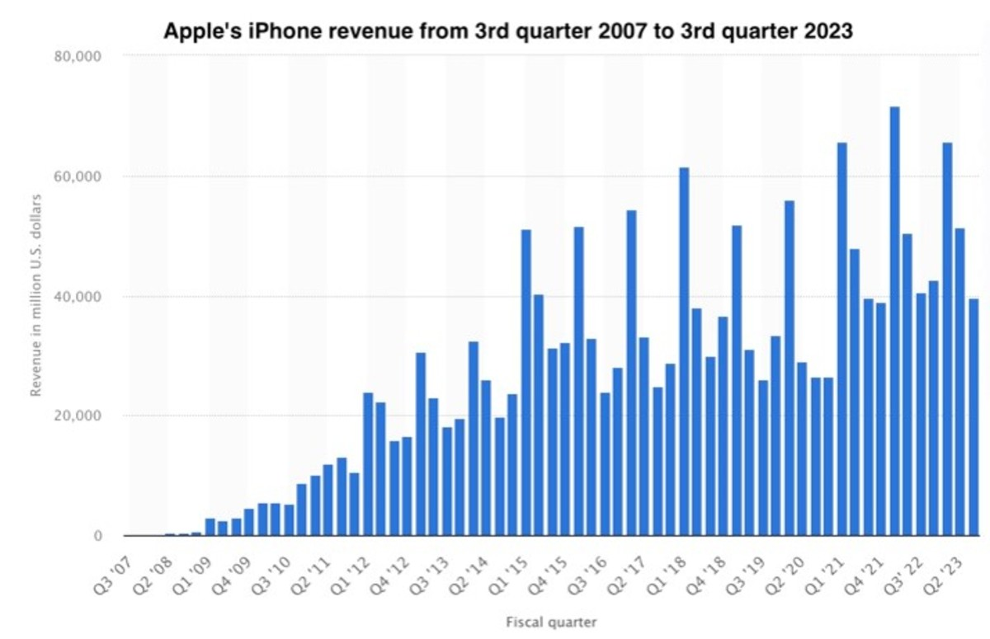
APPLE KEY STATISTICS
Apple generated $383.2 billion revenue in 2023, 52% came from iPhone sales
Apple Services is the second largest division, responsible for 22% of revenue in 2023
232 million iPhones, 61 million iPads and 26 million Mac and MacBook units were sold in 2022
Apple’s home and wearables division declined by 3.6% in 2023
It sold 82 million AirPods and 53 million Apple Watches in 2022
Apple Music has 88 million subscribers, Apple TV+ has over 75 million

Slide 15

SWOT ANALYSIS

Slide 16
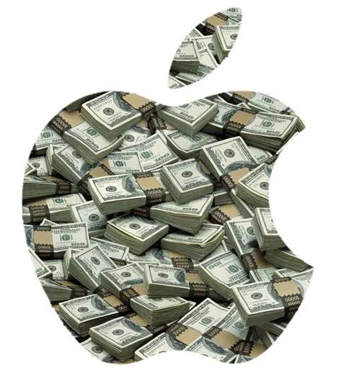
Strengths
Strong brand reputation: Apple is one of the most recognizable and respected brands in the world. This gives the company a significant advantage over its competitors.
Loyal customer base: Apple has a very loyal customer base, with many customers who are willing to pay a premium for the company's products.
Innovative products: Apple is known for its innovative products, which often set the standard for the industry.
Strong financial position: Apple has a very strong financial position, with a large cash hoard and a healthy balance sheet.
Global reach: Apple sells its products in over 150 countries around the world. This gives the company a large and diversified market base.

Slide 17
Weaknesses
Dependence on a few key products: Apple is heavily reliant on a few key products, such as the iPhone, iPad, and Mac. This makes the company vulnerable to changes in consumer demand or technological shifts.
High product prices: Apple's products are typically priced at a premium compared to its competitors. This can make them less affordable for some consumers.
Reliance on contract manufacturers: Apple relies on contract manufacturers to produce its products. This can make the company vulnerable to supply chain disruptions.
Legal and regulatory challenges: Apple has faced a number of legal and regulatory challenges in recent years, such as antitrust lawsuits and intellectual property disputes.

Slide 18
Opportunities
Growing demand for consumer electronics: The demand for consumer electronics is expected to continue to grow in the coming years. This is a good opportunity for Apple, as it is a leading manufacturer of consumer electronics products.
Expansion into new markets: Apple has the opportunity to expand into new markets, such as emerging markets. This could help the company to grow its revenue and customer base.
Development of new products and services: Apple has the opportunity to develop new products and services, such as wearable devices and augmented reality applications. This could help the company to maintain its competitive edge and attract new customers.
Growth of the services business: Apple's services business, such as the App Store and iCloud, is growing rapidly. This is a good opportunity for Apple, as it can help the company to diversify its revenue streams.

Slide 19
Threats
Increased competition: The competition in the consumer electronics industry is intensifying. This could put pressure on Apple's margins and profitability.
Economic downturn: An economic downturn could lead to a decrease in demand for Apple's products. This could hurt the company's revenue and earnings.
Technological disruption: Technological disruption could lead to the obsolescence of Apple's products. This could hurt the company's competitive advantage.
Geopolitical instability: Geopolitical instability could disrupt Apple's supply chain or make it difficult to sell products in certain markets.

Slide 20
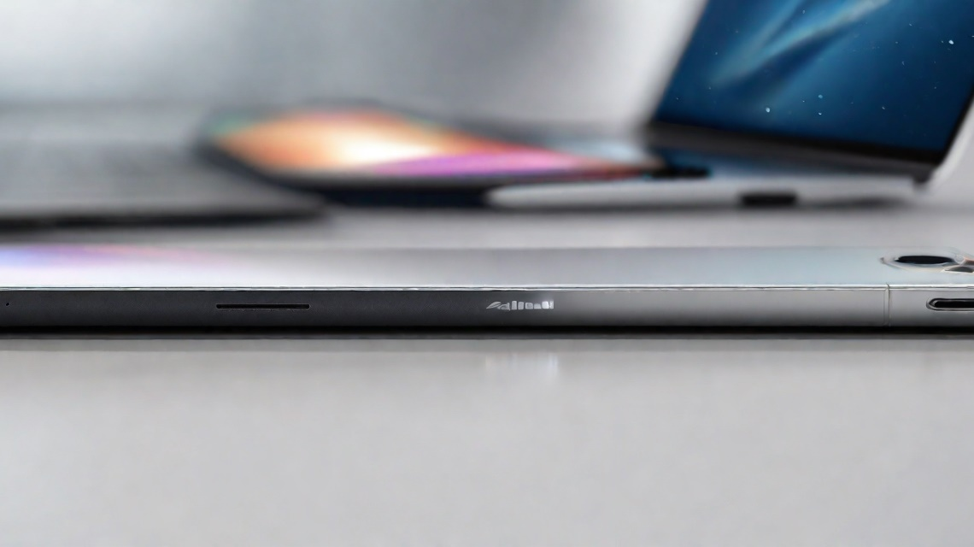
CONCLUSION

Slide 21

SHOULD WE INVEST OR NOT?
Based on the financial statement analysis and overall assessment of the company, it is recommended to invest in Apple.
Financial Analysis
The financial statements of Apple, including the common sized balance sheet and income statement, indicate a strong financial position and consistent growth over the years. The company has a healthy liquidity position, low debt levels, and strong profitability.
End of 2023: AAPL will continue its momentum and end 2023 at $200 per share, a 10.0% gain from today’s price and a 55% gain for all of 2023.
End of 2024: Stable or falling interest rates will create a tailwind for Apple stock, pushing it to $240 per share.
End of 2025: Apple will continue its lead in chip manufacturing and innovative design to lead the market. We expect the stock to reach $290 per share by the end of 2025.
End of 2030: Apple could reach a market cap of $8 trillion by 2030, representing a share price of $510. That is a 181% gain from today’s price.
Strong Buy Rating: Based on our Apple stock price forecast, we believe AAPL shares are a strong buy.

Slide 22

THANKS

